Slide 1
Excel Advanced
Session 4

Slide 2
Contents
More Functions
Conditional Formatting
Protect Cells
Project

Slide 3
Functions
Lookup Functions
Date & Time Functions
More Functions

Slide 4
Lookup Functions
VLOOKUP
HLOOKUP
XLOOKUP
MATCH
INDEX

Slide 5


VLOOKUP & HLOOKUP

Slide 6

XLOOKUP

Slide 7
Date Time Functions
Day
Month
Year
Workdays
Networkdays
YearFrac
Date
Today
Now

Slide 8
More Functions
Round
Rand
refrence

Slide 9
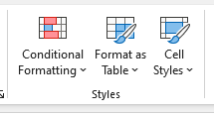
Conditional Formatting

Slide 10
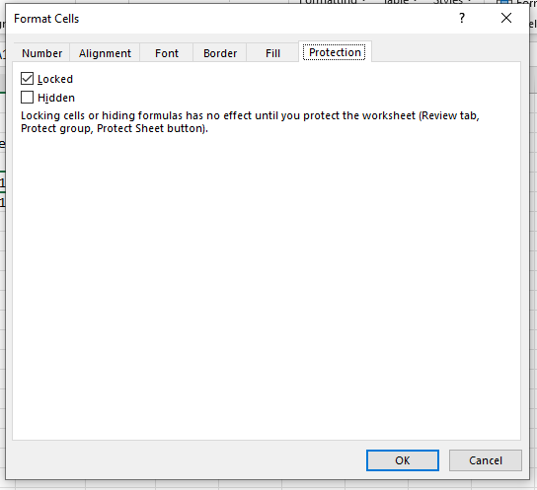
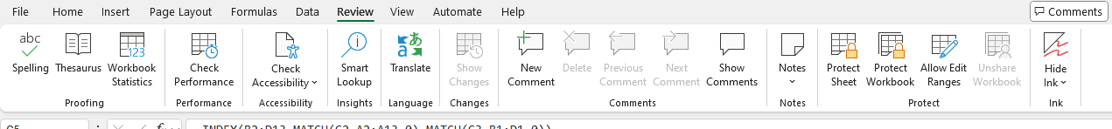
Protect Cells

Slide 11
Thank you
Brain Station
Eng. Dalia Morad
Excel Advanced S4

